Slide 1
Muon Cooling Project update 2/21/25
Daniel Fu

Slide 2
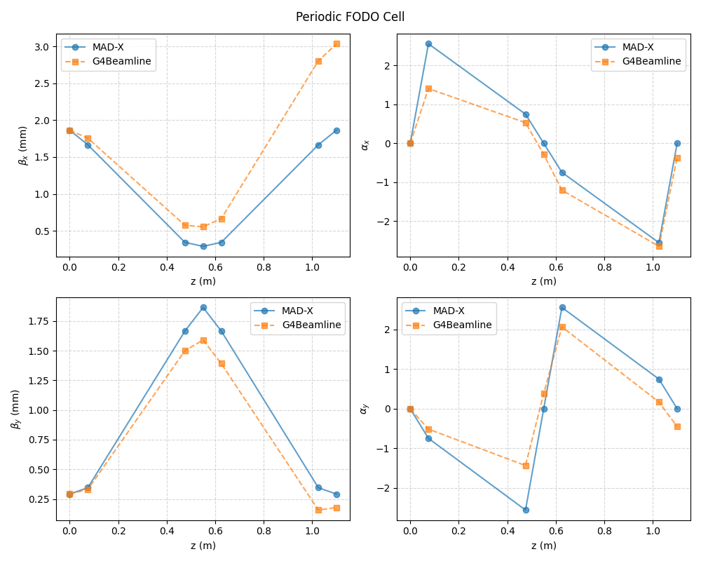
Drift channel converted from MAD-X to G4Beamline
Single repetition of the periodic FODO cell
Seems to match MAD-X results fairly closely
However, some discrepancies remain

Slide 3
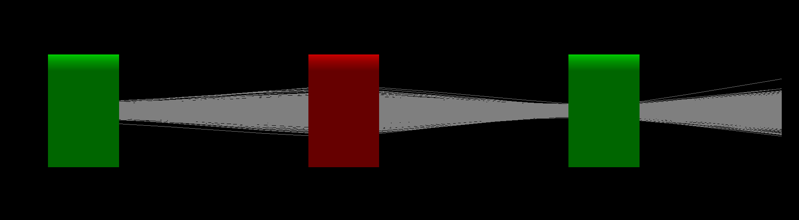
Image of FODO cell in G4Beamline

Slide 4
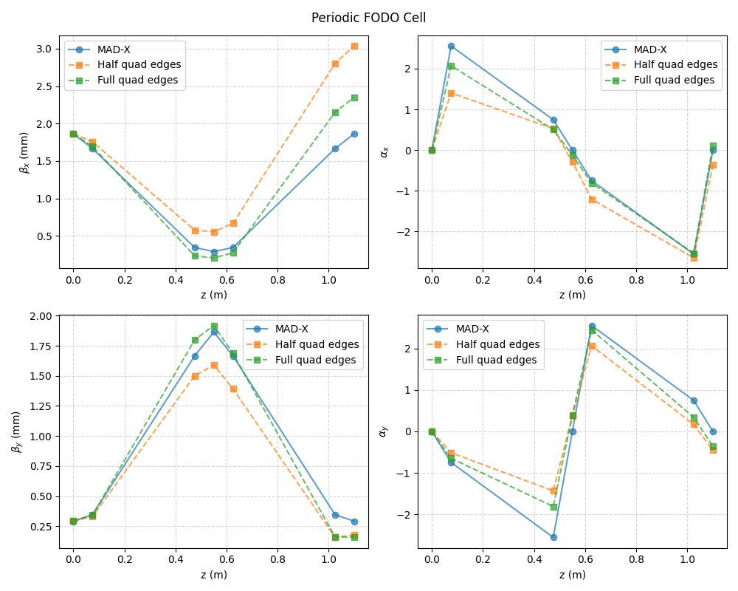
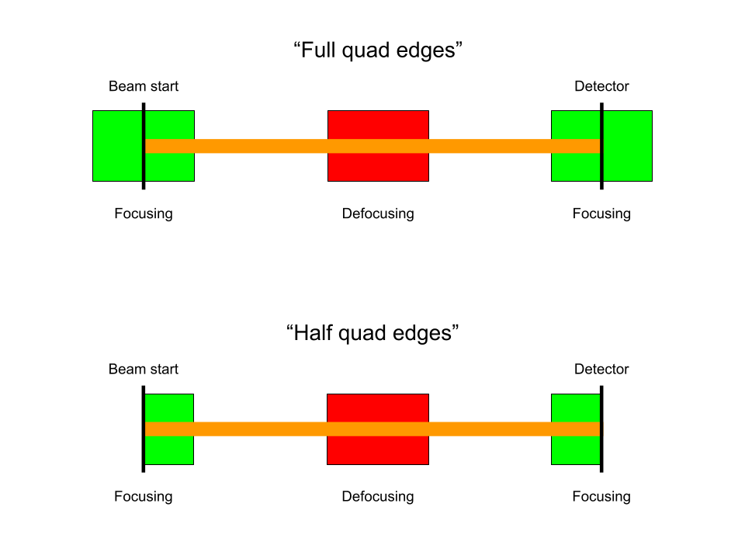
Question about cell layout
This is what is implemented in MAD-X

